Slide 1
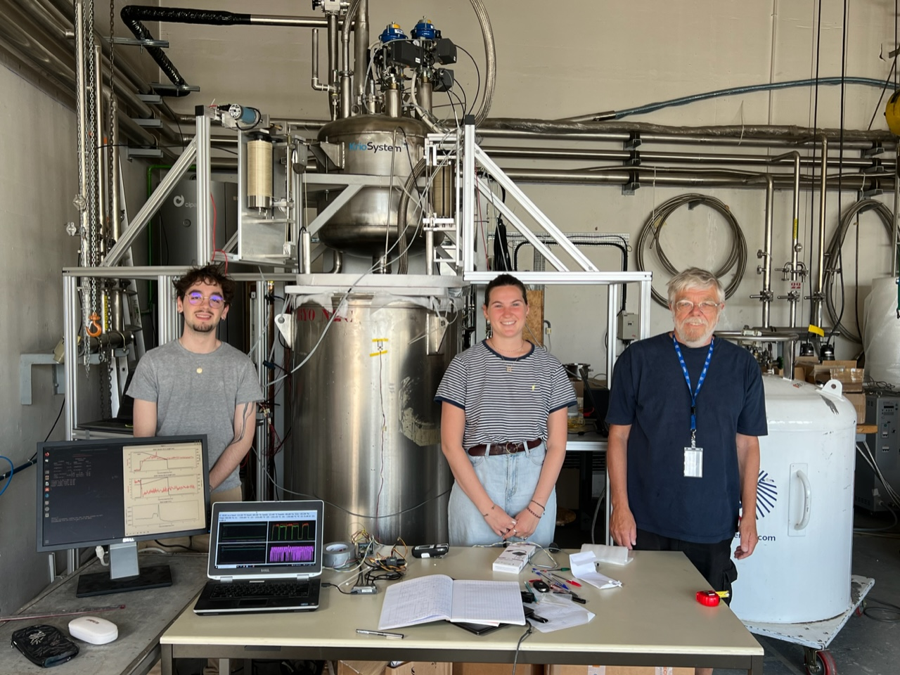
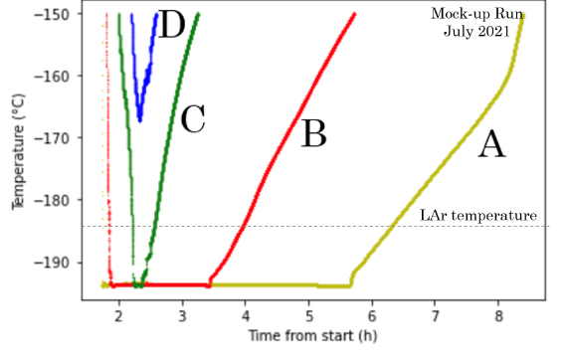
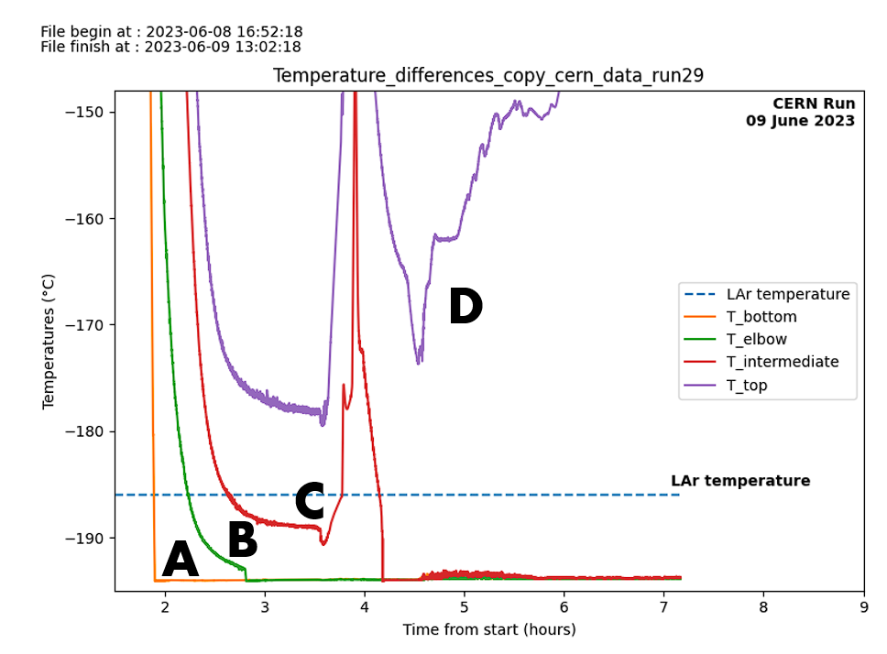
Comparing Mock-ups at Cold (1/2)
Short Run (0.4 m³)
CERN cryolab (B159)
LN2
Dewar2
LN2
Dewar1
Cryo
Long Run (1.6 m³)
Dewar1
Dewar 2
09-June 2023 (11:00)
Cryostat >90% filled with LN2 in 4 hours
gN2 flushing at 1 l/min (4 l/min during cooling)
3 lowest temperatures at -194^{O}C since 4 hours

Slide 2
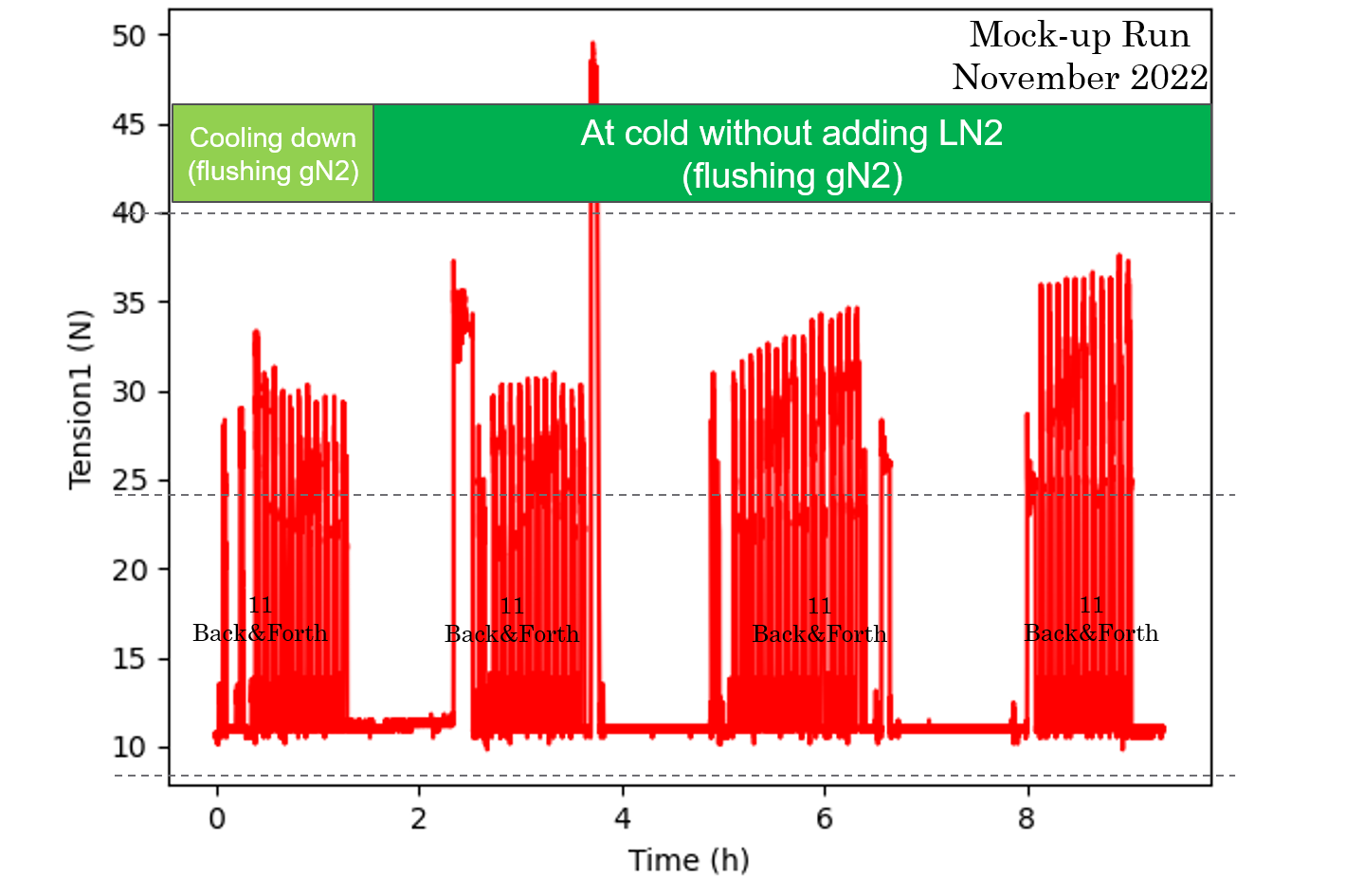
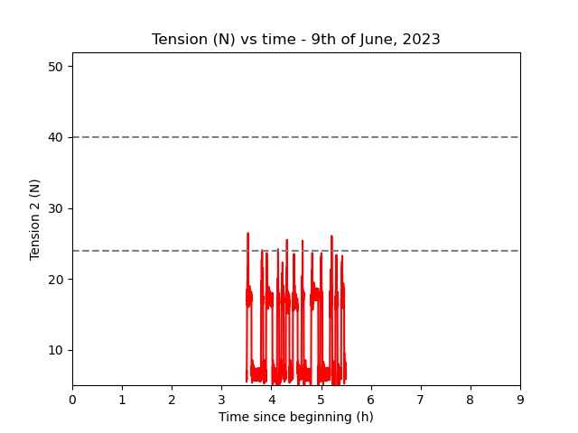
Comparing Mock-ups at Cold (2/2)
Short Run (Nov. 2022)
CERN cryolab (B159)
LN2
Dewar2
LN2
Dewar1
Cryo
Long Run (Jun. 2023)
09-June 2023 (11:00)
Cryostat >90% filled with LN2 in 4 hours
gN2 flushing at 1 l/min (4 l/min during cooling)
3 lowest temperatures at -194^{O}C since 4 hours
Tension around 20 N (CERN) wrt 30 N (Marseille)
Motor System works at CERN. To be continued during 1 month

Slide 3
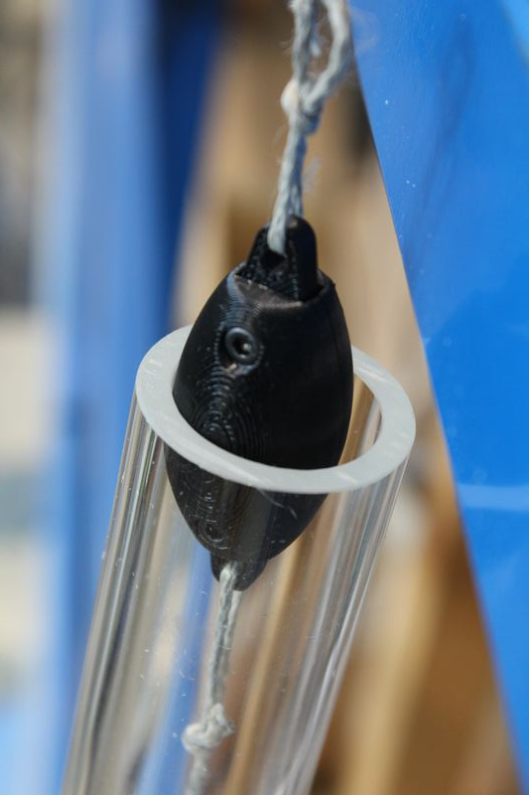
Pseudo–source
L = 5.5cm
φ = 2.5 cm
M= O(100) g

